Slide 1
TELCO CUSTOMER CHURN ANALYSIS
Prepared by Wisdom Ukah
AnalystLab Africa Weekly Assignment

Slide 2
Business Problem & Objectives
Business Problem
The telecom company is experiencing customer churn, resulting in revenue loss and increased customer acquisition costs. Understanding why customers leave is essential for improving customer retention.
Objectives
Analyze customer behavior.
Identify churn drivers.
Evaluate customer retention.
Build an interactive Power BI dashboard.
Recommend strategies to reduce churn.

Slide 3
Dataset Overview
Dataset: Telco Customer Churn
Total Customers: 7,043
Total Features: 21
Tool Used: Microsoft Power BI
Key Variables
Gender
Contract
Tenure
Internet Service
Payment Method
Monthly Charges
Churn

Slide 4
Data Preparation
Imported dataset into Power BI
Checked for missing values
Corrected data types
Cleaned inconsistent records
Created KPIs
Built interactive dashboard

Slide 5
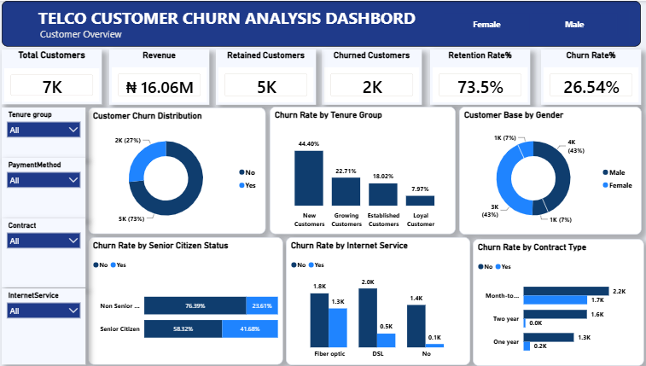
Dashboard Overview

Slide 6
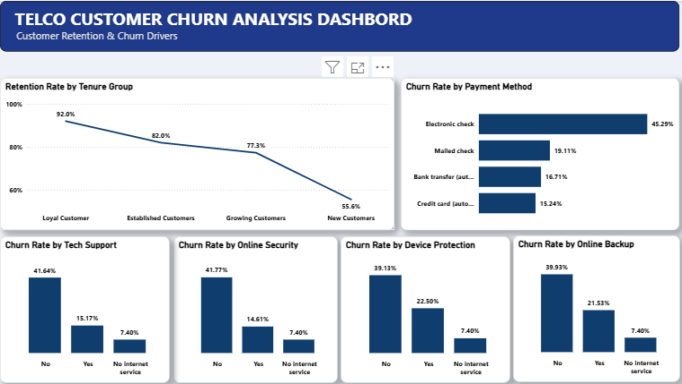
Dashboard Overview

Slide 7
Key Insights
Overall churn is significant: The overall churn rate is 26.54%, meaning more than one in four customers has churned. This indicates a significant customer retention challenge.
New customers are the highest risk tenure segment: New customers have the lowest retention rate at 55.6%, compared with 92.0% for loyal customers. This shows that the early customer period is particularly vulnerable to churn.
Contract type is strongly associated with retention: Month to month customers have the highest churn, while customers on longer term contracts demonstrate substantially better retention. This suggests that contract commitment is an important retention factor.
Electronic check users have the highest churn: Customers using electronic check have a 45.29% churn rate, considerably higher than customers using other payment methods.
Support and security services are associated with better retention: Customers without services such as Tech Support and Online Security show higher churn than customers who subscribe to these services, suggesting that additional support and security services may help improve retention.

Slide 8
Business Risks
High early-stage customer loss: The high churn among new customers creates a risk of losing customers before they develop long-term loyalty.
Dependence on month-to-month customers: The high churn associated with month-to-month contracts creates a retention risk if customers are not encouraged to move to longer-term plans.
High churn among electronic-check users: The 45.29% churn rate among electronic-check customers represents a particularly high-risk segment and could contribute significantly to customer losses.

Slide 9
Opportunities
Strengthen new-customer onboarding: Management can introduce targeted onboarding, follow-ups, and early engagement programs to convert new customers into long-term customers.
Encourage longer-term contracts: Offering incentives for customers to move from month-to-month plans to one- or two-year contracts could improve retention.
Promote support and security services: Bundling or offering targeted incentives for services such as Tech Support and Online Security could improve customer engagement and retention.

Slide 10
Recommendations
Create a new customer retention program with follow ups during the first few months to identify and address early signs of dissatisfaction.
Offer incentives for longer term contracts, such as discounts or additional benefits for customers who move from month-to-month plans.
Investigate electronic check customers to understand why their churn rate is substantially higher and encourage alternative payment methods where appropriate.
Promote Tech Support and Online Security services through targeted bundles, discounts, or free trial periods.
Develop targeted retention campaigns for high-risk customer segments, using customer characteristics such as tenure, contract type, payment method, and service subscriptions to identify customers most likely to churn.

Slide 11
Conclusion
This analysis identified the key drivers of customer churn and provided actionable recommendations to improve customer retention. The interactive dashboard enables management to make informed, data-driven decisions.
Thank You

